Slide 1
SKEWWNESS and KURTOSIS Presented by D. V. Patil Assistant Professor Dept. Animal Genetics and Breeding, Nagpur Veterinary College, Nagpur

Slide 2
“Mathematics is the only science where one never knows what one is talking about nor whether what is said is true” - Bertrand Russell
LET US GIVE A TRY !!!!!

Slide 3
SKEWNESS AND
KURTOSIS

Slide 4
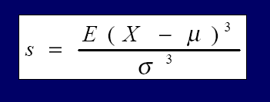
Defining Skewness
Skewness is the measure of asymmetry of the distribution of a real valued random
variable. It is the standardized 3rd central moment of a distribution
■
■
Positive Skewness indicates a long right tail Negative Skewness indicates a long left tail
■
Zero Skewness indicates a symmetry around the mean

Slide 5
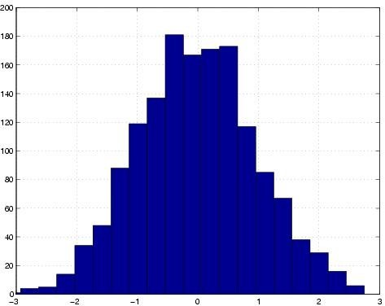
NORMAL DISTRIBUTION
SKEWNESS
NEGATIVE
POSITIVE

Slide 6
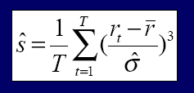
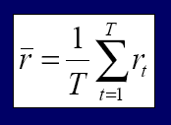
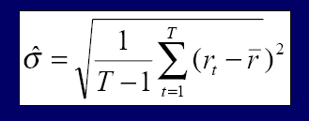
CALCULATING SKEWNESS
Given a set of returns r, t = 1,2…..T
Where r and sˆ are the estimated average and standard deviation

Slide 7
SKEWNESS ADJUSTMENT
SKEWNESS | Number of SD measure to achieve 99%
-2.83 | 3.99
-2.00 | 3.61
-1.00 | 3.03
-0.67 | 2.80
0.00 | 2.33
0.67 | 1.83
1.00 | 1.59
2.00 | 0.99
2.83 | 0.71
■
A gamma distribution is a better proxy for skewed portfolios
SYMMETRIC
(NORMAL DISTRIBUTION)

Slide 8
Example: Skewness
“Positively Skewed Distribution”
Suppose that we live in a neighborhood with 100 homes; 99 of them sell for $ 100,000, and one sells for $ 1,000,000.The median and the mode will be $ 100,000, but the mean will be $ 109,000. Hence, the mean has been "pulled" upward (to the right ) by the existence of one home (outlier) in the neighborhood.
■
■
For a negatively skewed distribution , the mean is less than the median , which is less than the mode. In this case, there are large, negative outlier s which tend to “pull" the mean downward (to the left ).

Slide 9
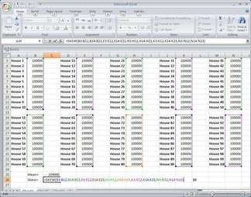
Spreadsheet - for Positively Skewed Distribution…

Slide 11
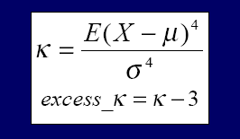
DEFINING KURTOSIS
KURTOSIS is a a measure of the "peakedness" of the probability distribution of a real-valued random variable. Its the standardized fourth
central moment of a distribution.
■
■
Kurtosis for he normal distribution is 3
Positive excess kurtosis indicate flatness (Long, Fat Tails) Negative excess kurtosis indicates peakedness
■

Slide 12
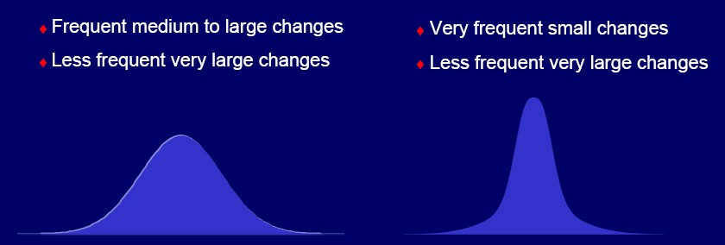
KURTOSIS

Slide 13
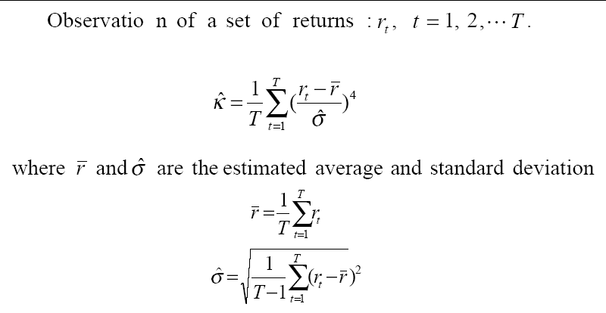
CALCULATING KURTOSIS

Slide 14
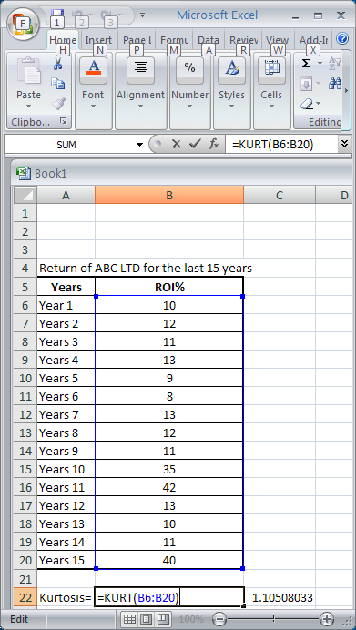
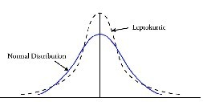
Example: Kurtosis

Slide 15
SOURCES
INTL CFA DERIVATIVE MODULE
CA MAFA MODULE
WIKIPEDIA
CASE STUDY ON MEASUREMENT

Slide 16
THANK YOU !!!
To
Prof. Mahendra Mehta

